Slide 1

Smart Agriculture Monitoring System: SAMS "Your Farm, Our Technology"
INFORMATION SYSTEMS AND PROJECT MANAGEMENT INSY 5373-001 SPRING 2024
Project Group 9
Ann Dinh
Anjali Nepal
Kaustubh Gawande
Swathi Manjunatha
Swikriti Bhattarai
Instructor
Ramakrishna Koganti

Slide 2

Defining

Slide 3
Project Name: Smart Agriculture Monitoring System (SAMS) | Champion: Swikriti Bhattarai
Business or Process Owner: Ann Dinh | Project Leader: Kaustubh Gawande
Problem Statement: In contemporary agriculture, farmers face multifaceted challenges ranging from imprecise environmental monitoring for diverse crops to inefficient resource usage, leading to problems such as water wastage, pest outbreaks, and sub-optimal fertilization. Climate change further exacerbates uncertainties. Smart Agriculture Monitoring System (SAMS) is a comprehensive system that seeks to integrate crop-specific environmental insights, optimize irrigation practices, detect and prevent pest and disease outbreaks, refine fertilization strategies, and adapt to climate variations, thereby fostering sustainable and resilient agricultural practices. | Project Goal: The primary goal of this project is to improve crop management techniques by giving farmers access to real-time data and predicted insights about the properties of soil. It will also maximize resource utilization and raise overall productivity to support sustainable agriculture and economy.
Business Case: SAMS utilizes real-time data on temperature, humidity, soil moisture, and crop health for informed decisions on pest management, fertilization, and irrigation. The system employs ML algorithms to forecast issues and suggest preventive actions. Product Launch Strategy: Initially targeting rural areas in emerging nations with significant agricultural activity. Collaboration with regional agriculture organizations for implementation. Market Analysis: SAMS distinguishes itself with a comprehensive solution combining ML predictive analysis and IoT real-time data collection to reduce resource waste and enhance crop productivity. Unique Feature: Advanced sensors and ML algorithms provide precise and fast insights into crop conditions. The user-friendly interface offers farmers practical suggestions. Target Customers: Small and large-scale farmers, agricultural cooperatives, and agribusinesses. Investments: $200,000 Targeted Returns: Greater overall efficiency for farmers, lower resource costs, and higher crop yields. Financial returns are assessed based on adaptation level. Future Expansions: 1) Integration with automated irrigation systems. 2) Collaboration with agricultural research institutions for continuous improvement. | Project Scope: The project scope for SAMS includes the creation and implementation of a comprehensive precision agricultural system. This involves developing IoT sensors to track essential soil properties including pH, temperature, moisture content, and nutrient levels. Moreover, ML algorithms will be used for predictive analysis, providing information on crop production estimation and soil health. To make it easier for farmers to access and analyze historical and real-time data, the project also focuses on designing and implementing a user-friendly app. To make sure farmers are using the system efficiently, training sessions will also be held. Benefits: Enhances the quantity and quality of crops. Detects crop diseases and pest infestations early on. Enables farmers to make informed decisions based on data. Reduces resource wastage through optimized irrigation and fertilization. Increases farmers' competitiveness, leading to more opportunities. Promotes sustainable practices by precisely managing resources and reducing environmental impact. Timeline: Start Date: 05/18/2022 - End Date: 05/21/2024
Team Members: Ann Dinh Anjali Nepal Kaustubh Gawande Swathi Manjunatha Swikriti Bhattarai
Defining – 4 months | Planning – 5 months | Executing – 11 months | Closing - 4 months
Initiation, market research, defining project’s goal and objective, stakeholders, & deliverables | Resource allocation, risk assessment, tasks and responsibilities, determining timeline | Sensor deployment, software development, user training | Monitoring, evaluation & documentation, post-project review

Slide 4
Objectives *Provide real-time monitoring of environmental conditions such as soil moisture, temperature, and humidity. *Enable data-driven decision-making for irrigation, fertilization, and pest management. *Predict and prevent crop diseases and yield losses through advanced analytics and machine learning algorithms.
Introduction
Key Features:
Benefits:
Sensor-based monitoring for precise data collection.
AI-based analytics for real-time insights and predictive modeling.
Mobile and web interfaces for remote access and control.
Scalable and customizable to suit diverse agricultural needs.
Increased crop yield and quality.
Water and resource conservation.
Reduced operational costs and risks.
Addresses potential threats such as drought, frost, and disease outbreaks before they escalate.

Slide 5
Why SAMS?
Traditional farming practices lack real-time monitoring and data-driven decision-making capabilities, which significantly impact the efficiency, productivity, and sustainability of agricultural operations.
Impact:
Reduced crop yields, lower quality produce, increased production costs, and environmental degradation contribute to financial losses, operational inefficiencies, and sustainability challenges for farmers.
Conclusion:
Addressing the limitations of traditional farming practices through the adoption of advanced technology and data-driven solutions is essential to overcome the identified challenges and improve productivity, profitability, and sustainability.

Slide 6
ROI/Payback
Estimations:
Initial Investment: $500,000
Annual Operating Costs: $20,000
Annual Revenue: $100,000 (20% Inc YOY).
Project Lifespan: 5 years
Cost Projections Over 5 Years:
Year 1 Net Cash Flow : -$120,000
Net Profit over 5 years: $444,160
Return on Investment (ROI) : 222.08%.
Payback period : 2.16 years

Slide 7
COST ANALYSIS
Deliverables | Cost ($)
Hardware Procurement | $20,000 - $30,000
Software Development | $230,000 - $250,000
Machine Learning Model Development | $150,000 - $160,000
Integration and Testing | $70,000 - $90,000
Pilot Deployment | $10,000 - $30,000
Operational Expense | $50,000 - $60,000
Marketing Expenses | $40,000 - $50,000
Minimum Estimated Cost: $570,000 and Maximum Estimated Cost: $670,000

Slide 8
Planning Phase

Slide 9
Communication Plan
Communication Objective | Stakeholders | Key Messages | Communication Channels | Responsible Parties | Time
Raise awareness about SAMS | Farmers | Improved crop productivity, Technological innovation | Workshops and training sessions | Project Manager | Mid and end of the project
 |  | Resource efficiency, Resilience to climate change | Farmer outreach events like agricultural fairs and exhibition
Promote partnerships & collaboration | Agricultural technology | Collaboration opportunities | Industry conferences and forums | Project Manager | Throughout and after the project
 | Providers | Value of joint innovation | Webinars
Clear & Consistent Communication | Project Team | Introduction to SAMS and its benefits | Regular Team Meetings | Project Manager | Throughout the project
 | Farmers | Compliance with agricultural regulations | Project Documentation | Marketing Team | After the project
 | Project Investors & Sponsors | Benefits of SAMS | Reports and Email Updates | Project Manager | Throughout the project
Team Meetings | Project Manager | Introduction to SAMS and its benefits | Regular Team Meetings | Project Manager | Throughout and weekly
Email Updates | Investors, Project Team, Project Manager | Project Progress and milestones | Email Updates | Project Manager | Throughout and weekly
App Development Updates | Project Team, Developers | Application development & Updates | Email Updates, Team Meetings | Project Lead, Design & Development Team | Throughout and weekly
Social Media Promotion | Marketing Team | Marketing and Promotion strategies | Social Media Platforms | Marketing Team, Project Lead | Towards the end and after the project

Slide 10

SWOT ANALYSIS
Strengths Enhanced Productivity Resource Efficiency Resilience to Climate Change Technological Innovation | Weaknesses Initial Investment Costs Technical Complexity Data Privacy and Security Concerns Dependency on Connectivity
Opportunities Market Growth Partnerships and Collaboration Policy Support and Incentives Customization and Scalability | Threats Market Competition Regulatory Compliance Resistance to Change Technological Risks
(Fresno State Library 2024)
Notes:
Strengths:
Enhanced Productivity: SAMS has the potential to significantly enhance agricultural productivity by providing farmers with actionable insights for optimizing irrigation, fertilization, and pest management practices.
Resource Efficiency: By enabling precise environmental monitoring and data-driven decision-making, SAMS promotes efficient use of resources such as water, fertilizers, and pesticides, leading to cost savings and reduced environmental impact.
Resilience to Climate Change: SAMS helps farmers adapt to climate variations and mitigate risks associated with climate change, such as extreme weather events and shifting growing seasons, by providing timely alerts and recommendations.
Technological Innovation: SAMS leverages advanced technologies such as IoT, AI, and data analytics to deliver cutting-edge solutions for modern agriculture, driving innovation and competitiveness in the agricultural sector.
Weaknesses:
Initial Investment Costs: The deployment of SAMS infrastructure, including sensors, software, and data analytics platforms, may require a significant upfront investment for farmers, posing a barrier to adoption, particularly for small-scale producers with limited financial resources.
Technical Complexity: SAMS involves the integration of multiple technologies and data sources, which can be technically complex and require specialized expertise for setup, maintenance, and troubleshooting, potentially limiting accessibility for some farmers.
Data Privacy and Security Concerns: SAMS collects and processes sensitive agricultural and environmental data, raising concerns about data privacy, security, and ownership. Ensuring robust data protection measures and addressing privacy concerns is essential for building trust and adoption among farmers.
Dependency on Connectivity: SAMS relies on reliable internet connectivity and network infrastructure for real-time data transmission and analysis. In regions with limited connectivity or unstable networks, reliability and performance may be compromised.
Opportunities:
Market Growth: The growing global demand for sustainable food production and increasing adoption of precision agriculture technologies present significant market opportunities for SAMS providers to expand their customer base and market reach.
Partnerships and Collaboration: Collaborating with agricultural stakeholders, technology partners, and research institutions can facilitate the development, validation, and deployment of SAMS solutions, leveraging complementary expertise and resources.
Policy Support and Incentives: Government initiatives, subsidies, and regulatory frameworks promoting sustainable agriculture practices and digital innovation can create favorable conditions for the adoption of SAMS and incentivize investment in agricultural technology.
Customization and Scalability: SAMS can be tailored to the specific needs and conditions of different crops, regions, and farming systems, offering opportunities for customization and scalability to address diverse agricultural contexts and market segments.
Threats:
Market Competition: The agricultural technology market is highly competitive, with numerous companies and startups offering similar solutions to SAMS. Intense competition may exert pressure on pricing and margins, challenging the viability and profitability of SAMS providers.
Regulatory Compliance: Compliance with evolving data privacy, environmental, and agricultural regulations and standards can pose challenges for SAMS providers, requiring continuous monitoring and adaptation to ensure legal and regulatory compliance.
Resistance to Change: Resistance to change and traditional farming practices, coupled with cultural, social, and educational barriers, may hinder the adoption of SAMS among farmers, necessitating targeted education, training, and support initiatives to facilitate adoption and behavior change.
Technological Risks: Rapid technological advancements, including hardware obsolescence, software compatibility issues, and cybersecurity threats, pose risks to the reliability, performance, and longevity of SAMS solutions, requiring ongoing investment in research and development to stay competitive and resilient.
By addressing these internal strengths and weaknesses while capitalizing on external opportunities and mitigating threats, the Smart Agriculture Monitoring System (SAMS) project can position itself for success and make a meaningful impact on sustainable and resilient agriculture.

Slide 11
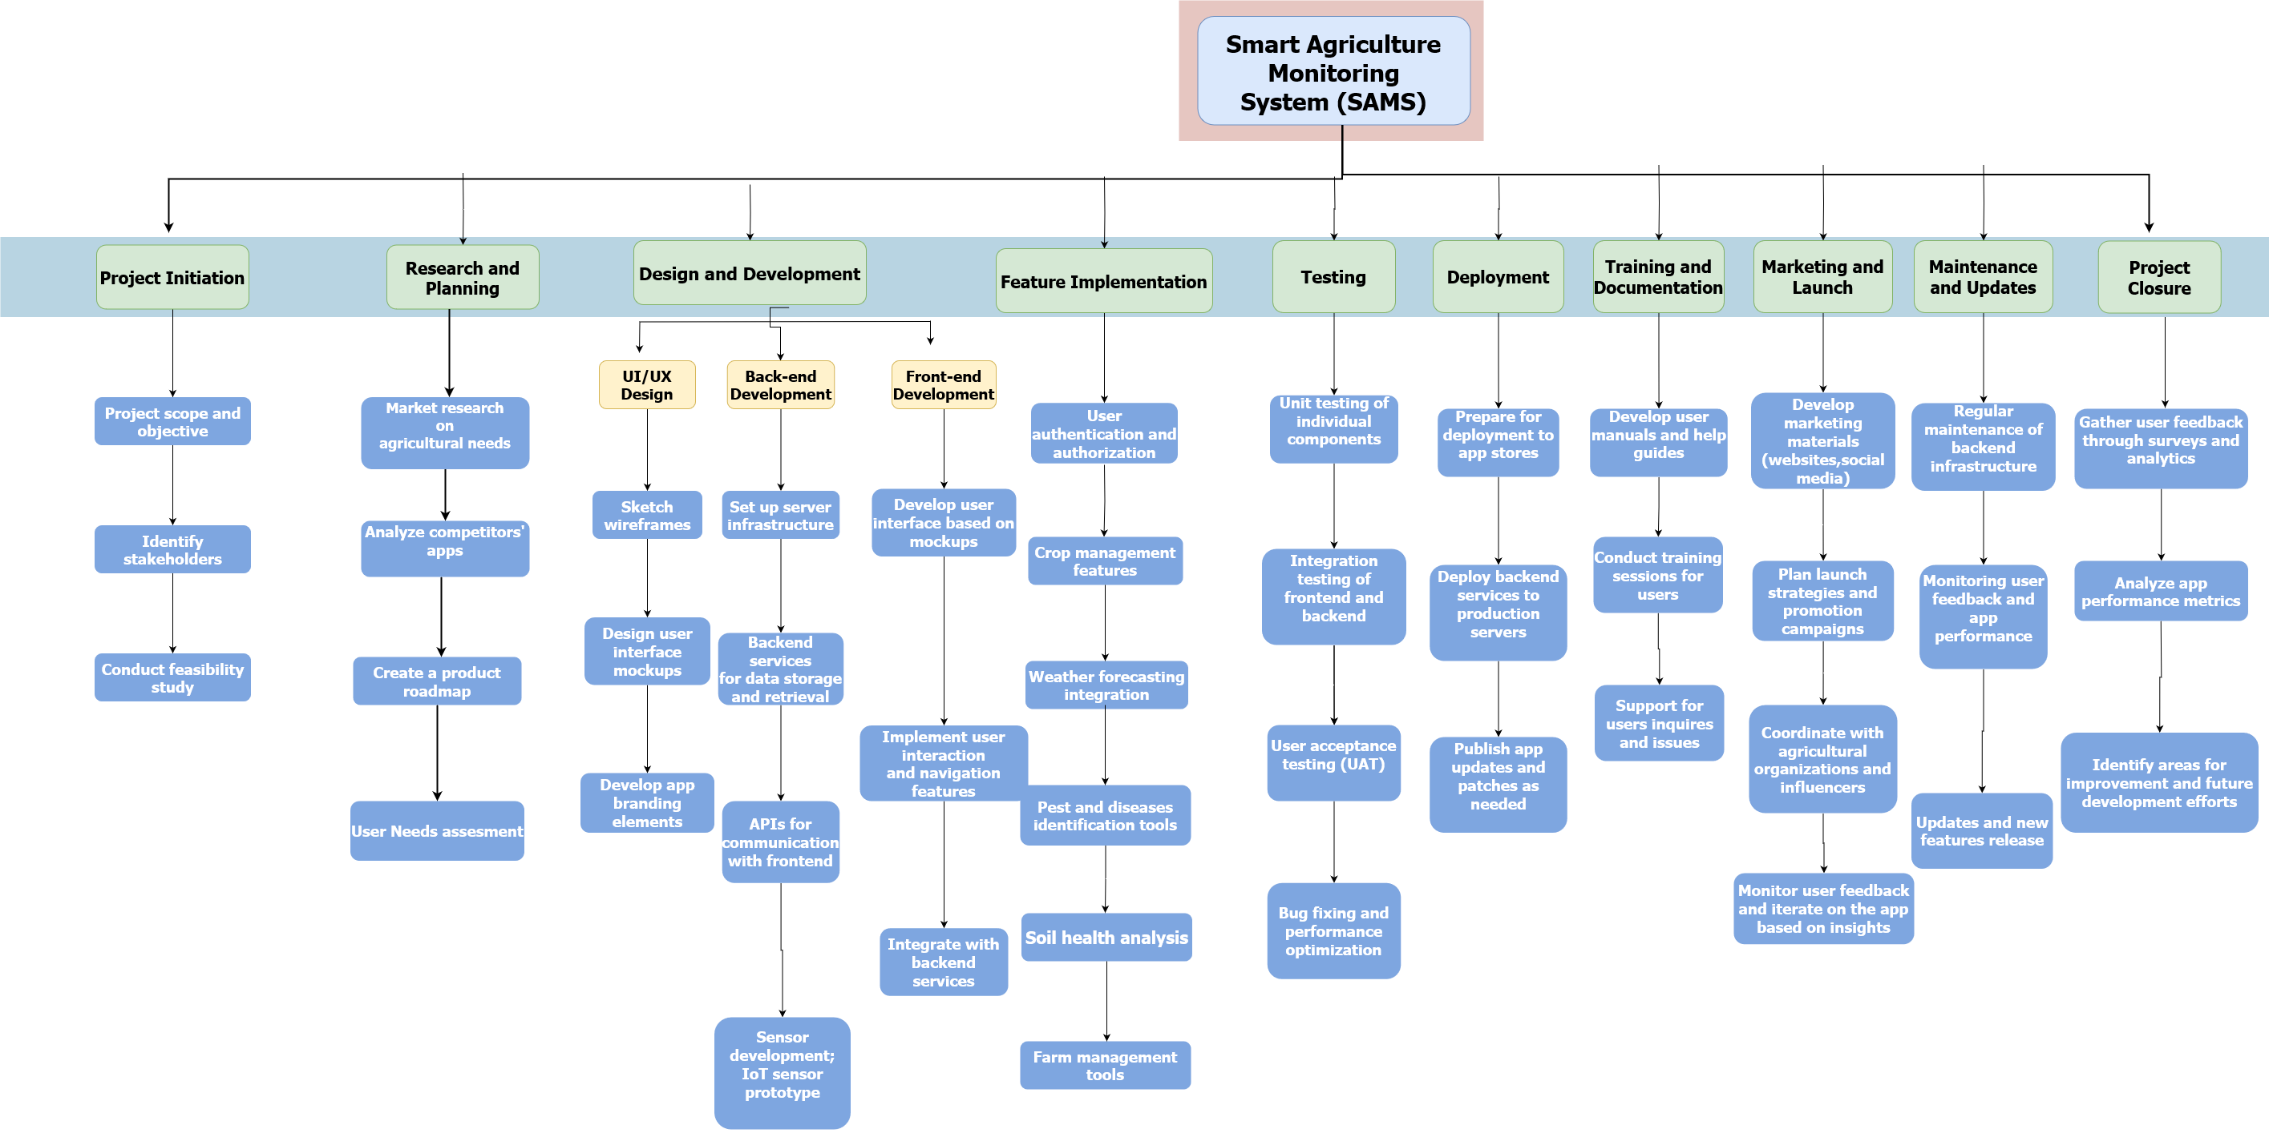
Work Breakdown Structure (WBS)

Slide 12
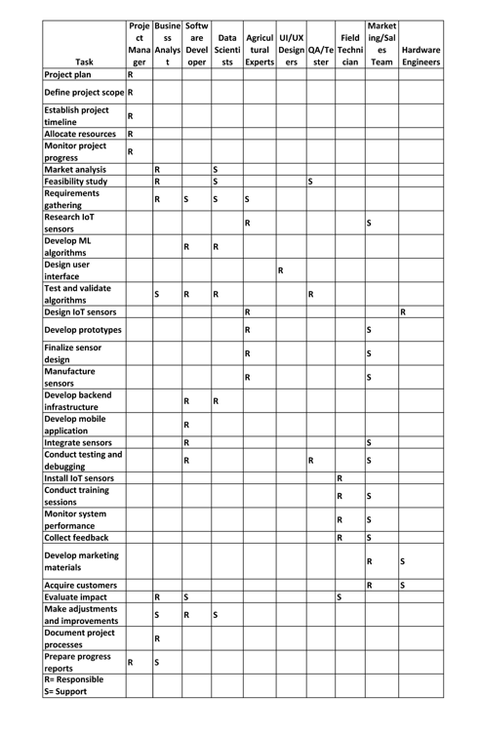
Responsibility Matrix
Notes:
R- Responsibility
S- Support

Slide 13
Network Diagram
ES
ID
EF
SL
Desc
SL
LS
Dur
LF
1 B 3
Legend
0 0
Stakeholder
Analysis
1 2 3
0 A 1
Project Initiation
0 0
8 E 13
16 G 18
20 I 21
1 1 1
1 C 4
0 0
0 0
0 0
0 0
Development
Implement
Document &
Handover
Requirements Gathering
8 5 13
16 2 18
20 1 21
1 3 4
4 D 8
13 F 16
18 H 20
System
Design
User
Training
0 0
0 0
0 0
Test & Quality Assurance
4 4 8
18 2 20
13 3 16

Slide 14
Project Schedule
Phase 1: Defining
May 18th 2022 - July 17th 2022
Phase 2: Planning
July 18th 2022 – October 3rd 2023
Phase 3: Execution
Phase 4: Closing
May 14th 2024 – May 21st 2024
April 16th 2024- May 13th 2024

Slide 15
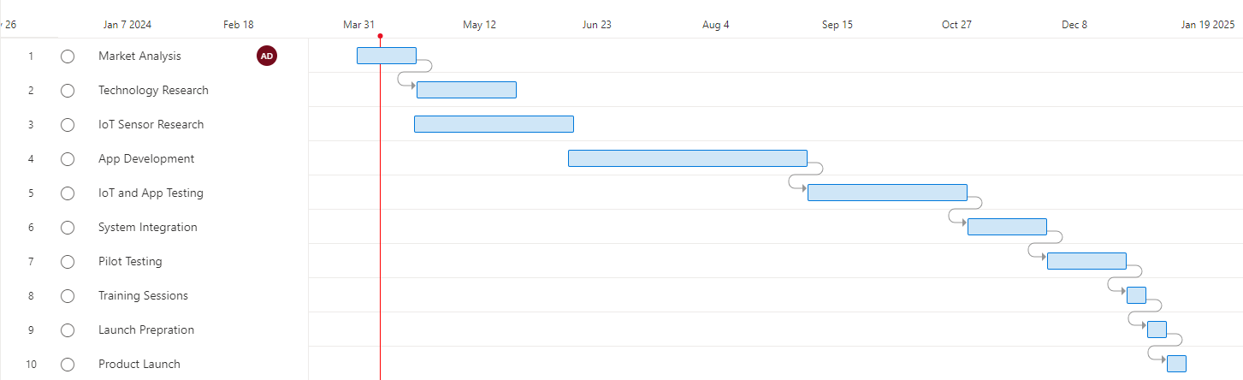
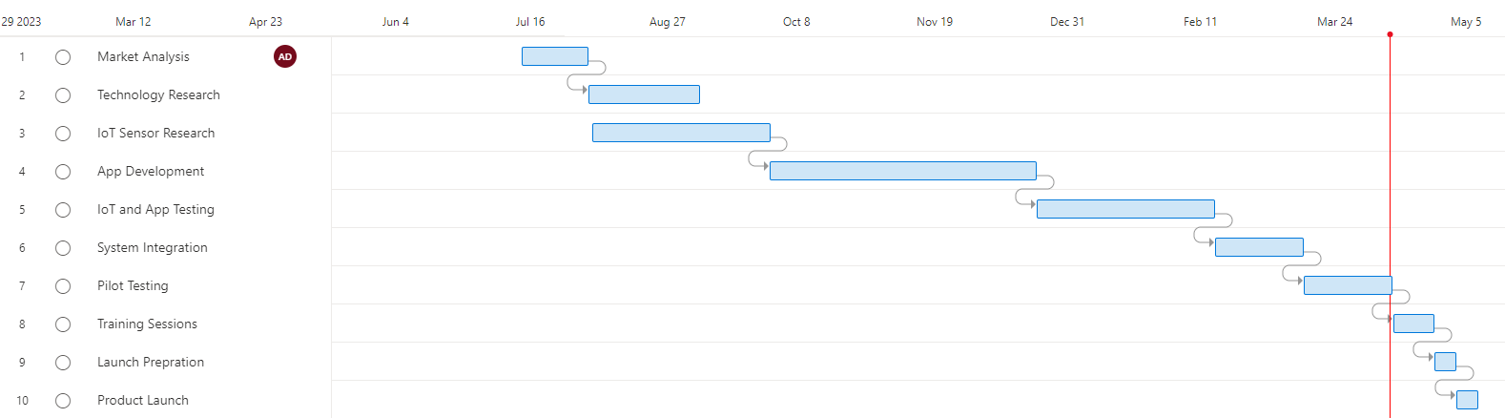
Gantt Chart

Slide 16



Execution Phase

Slide 17
ML Model & Web App Development (Central Monitoring System)
ML Algorithm Development
Web App Design
Adoption of HTML, CSS, JavaScript, and frameworks like React.
UI components created as per design mockups for visual consistency.
Web App Features
Testing and Accessibility
Design and development of user-friendly web app interface.
Provision of predictive analysis capabilities for crop yield forecasting.
Implementation of responsive design principles for multi-device compatibility.
Addition of context menu feature for enhanced user interaction.
Testing for consistent rendering across various browsers.
Implementation of accessibility features for usability by individuals with disabilities.
Creation and training of ML algorithms for data analysis and predictive insights.
Iterative refinement of ML models to enhance accuracy and reliability.
Utilization of Python, TensorFlow, and scikit-learn for algorithm development.

Slide 18
Sensor Deployment:
Identified agricultural fields for sensor deployment.​
Researched and defined sensor requirements based on agricultural monitoring needs (e.g., pH levels,soil moisture, temperature, humidity).​
Designed sensors to withstand outdoor environmental conditions and ensure durability.​
Developed prototypes of IoT sensors based on the defined specifications.​
​ Hardware Setup & Configuration:​
Deploying IoT sensors across agricultural fields for data collection ​
Set up a network infrastructure to support the communication and data transmission from sensors to the web application​.
Procurement and installation of hardware components like data loggers, gateways, and servers, ensuring scalability and reliability.
Coordination with vendors to address compatibility issues and mitigate system conflicts.
Seamless integration and compatibility between various sensor models and hardware components.
Consideration of environmental factors impacting sensor performance and implementation of safeguarding strategies.
Establish protocols for data aggregation, storage, and visualization.

Slide 19
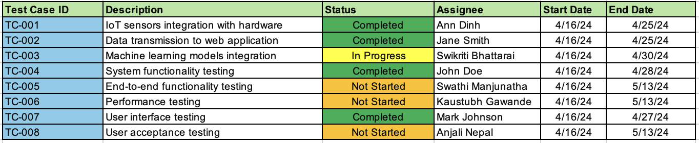
Integration & Testing Phase
Integration of diverse components: Combining IoT sensors, ML models, web apps, and hardware into a unified system.
Seamless data flow:Ensuring smooth interaction between modules for end-to-end functionality.
Testing for validation: Utilizing various methodologies to verify system behavior and compliance.
Continuous monitoring: Gathering feedback for timely issue resolution.
Efficient resource utilization: Optimal allocation of human, financial, and technological resources within project constraints.

Slide 20
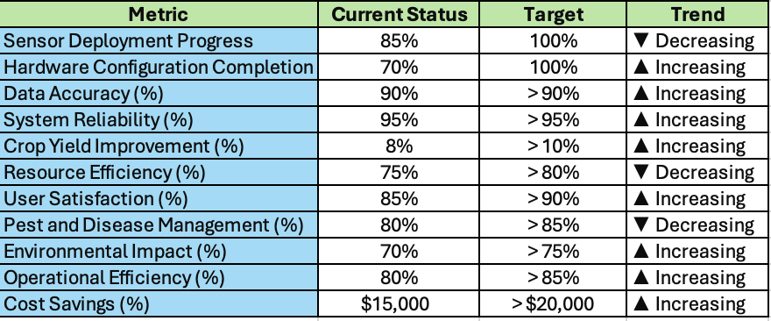
Pilot Deployment & Data Collection
Conducted pilot deployment in selected rural areas with significant agricultural activity to implement SAMS components.
Collaborated closely with regional agriculture organizations and stakeholders to ensure seamless implementation and garner local support.
Utilized a variety of IoT sensors, weather stations, and data loggers to gather comprehensive data on key agricultural parameters.
Implemented both historical and real-time data collection methods to capture longitudinal trends and immediate insights.
Employed advanced data analysis techniques such as statistical analysis, machine learning algorithms, and predictive modeling to derive actionable insights.
Evaluated crop performance, soil health, pest infestations, and other relevant factors to inform decision-making and optimize agricultural practices.
Tracked and analyzed key performance indicators (KPIs) throughout the pilot deployment phase to assess progress and performance.

Slide 21

Project Closure

Slide 22
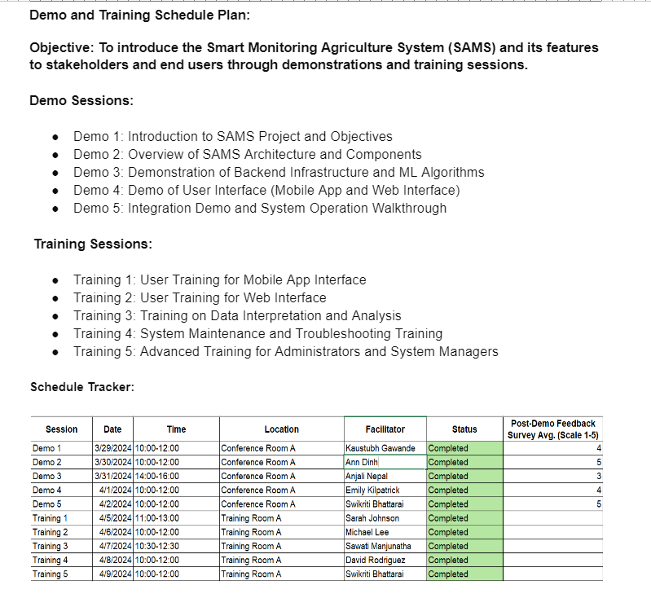

Demos & Training Schedule Tracker

Slide 23
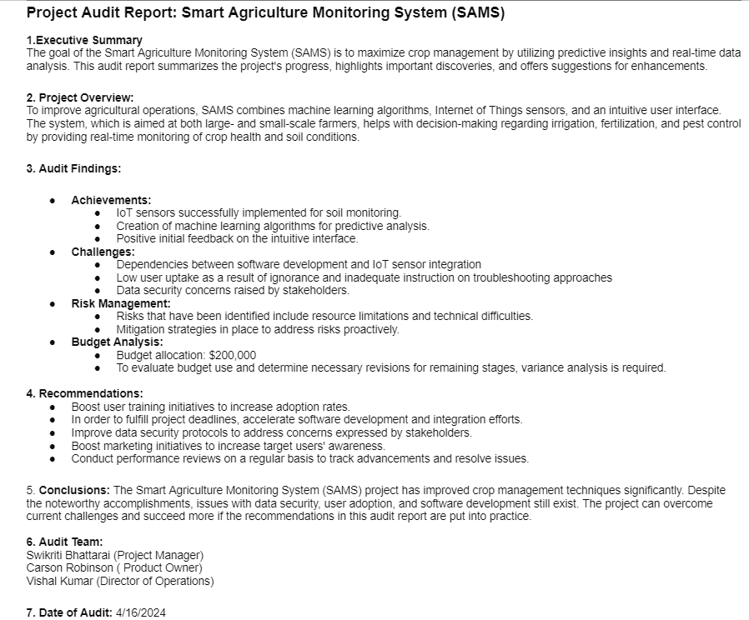
Project Audit Report

Slide 24
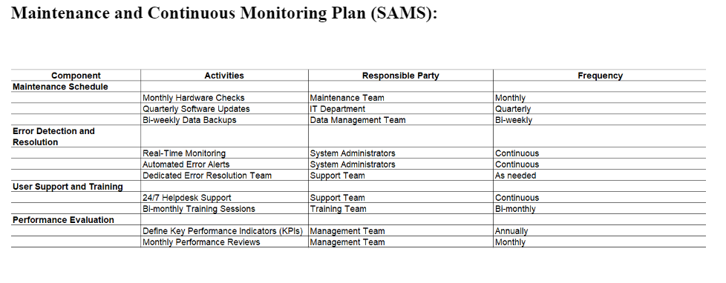

Slide 25

Conclusion
Successful implementation of SAMS revolutionizes agriculture with real-time data insights.
Collaboration, resilience, and adaptability are key to overcoming challenges.
Anticipate tangible impacts on crop management and sustainability.
SAMS sets a new standard for precision agriculture, bridging technology and farming practices.
The project highlights the transformative potential of technology in addressing agricultural challenges and fostering sustainability. Lessons Learned:
Effective stakeholder management ensures alignment of goals and expectations.
Agile methodologies enable flexibility and responsiveness to changes.
Proactive risk management minimizes project disruptions.
Collaboration and teamwork leverage diverse expertise for success.
Continuous improvement drives efficiency and effectiveness in future initiatives.
Timely integration planning ensures smooth project execution and minimizes delays.

Slide 26
Reference
Fresno State Library. “Libguides: AGBS 120: Agribusiness Management: SWOT Analysis.” AGBS 120: Agribusiness Management, LibGuides at California State University Fresno,14 Feb. 2024. https://guides.library.fresnostate.edu/c.php?g=289058&p=7200990. Accessed 18 April 2024.

